Slide 1
File Organization
Database Systems

Slide 2
File Organization
A database consist of a huge amount of data.
File organization is used to describe the way in which the records are stored in terms of blocks, and the blocks are placed on the storage medium.
The data is grouped within a table in RDBMS, and each table have related records.
A user can see that the data is stored in form of tables, but in acutal this huge amount of data is stored in physical memory in form of files.
File – A file is named collection of related information that is recorded on secondary storage such as magnetic disks, magnetic tables and optical disks.
The File is a collection of records.
Using the primary key, we can access the records.

Slide 3
File Organization
The type and frequency of access can be determined by the type of file organization which was used for a given set of records.
File organization is a logical relationship among various records.
This method defines how file records are mapped onto disk blocks.
The first approach to map the database to the file is to use the several files and store only one fixed length record in any given file.
An alternative approach is to structure our files so that we can contain multiple lengths for records.
Files of fixed length records are easier to implement than the files of variable length records.

Slide 4
Types of Mapping
Spanned Mapping
Unspanned Mapping

Slide 5
Spanned Mapping
In spanned mapping, the record of a file is stored inside the block even if it can only be stored partially and hence, the record is spanned over two blocks giving it the name Spanned Mapping.
Advantages: No wastage of memory.
Disadvantages: The record which has been spanned, while accessing it we would be required to access two blocks and searching time of a block is greater than the searching time of a record inside a block as the number of blocks on the disk are too large.

Slide 6
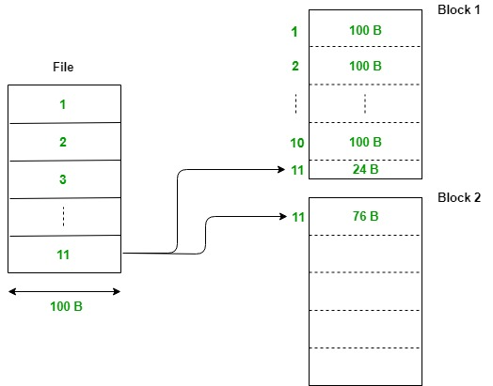

Slide 7
Unspanned Mapping
In unspanned mapping, unlike spanned strategy, the record of a file is stored inside the block only if it can be stored completely inside it.
Advantages: Access time of a record is less. It is because in spanned mapping, for accessing the spanned record we were required to access two blocks and as we know accessing time of a block is much higher than that of a record. But in unspanned mapping, for a single record we need to access only a single block every time and hence, it is faster.
Disadvantages: Wastage of memory is more.

Slide 8
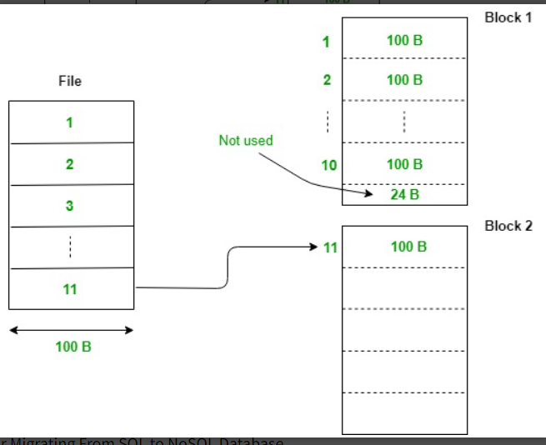

Slide 9
Types of file organization
File organization contains various methods.
These particular methods have pros and cons on the basis of access or selection.
In the file organization, the programmer decides the best-suited file organization method according to his requirement.
Types of file organization are as follows:
Sequential file organization
Heap file organization
Hash file organization

Slide 10
Sequential File Organization
This method is the easiest method for file organization.
In this method, files are stored sequentially.
This method can be implemented in two ways:
Pile file method
Sorted file method

Slide 11
1. Pile File Method
It is a quite simple method.
In this method, we store the record in a sequence, i.e., one after another.
Here, the record will be inserted in the order in which they are inserted into tables.
In case of updating or deleting of any record, the record will be searched in the memory blocks.
When it is found, then it will be marked for deleting, and the new record is inserted.

Slide 13
2. Sorted File Method
In this method, the new record is always inserted at the file's end, and then it will sort the sequence in ascending or descending order.
Sorting of records is based on any primary key or any other key.
In the case of modification of any record, it will update the record and then sort the file, and lastly, the updated record is placed in the right place.

Slide 15
Pros of sequential file organization
It contains a fast and efficient method for the huge amount of data.
In this method, files can be easily stored in cheaper storage mechanism like magnetic tapes.
It is simple in design.
It requires no much effort to store the data.
This method is used when most of the records have to be accessed like grade calculation of a student, generating the salary slip, etc.
This method is used for report generation or statistical calculations.

Slide 16
Cons of sequential file organization
It will waste time as we cannot jump on a particular record that is required but we have to move sequentially which takes our time.
Sorted file method takes more time and space for sorting the records.

Slide 17
Heap file organization
It is the simplest and most basic type of organization.
It works with data blocks.
In heap file organization, the records are inserted at the file's end.
When the records are inserted, it doesn't require the sorting and ordering of records.
When the data block is full, the new record is stored in some other block.
This new data block need not to be the very next data block, but it can select any data block in the memory to store new records.
The heap file is also known as an unordered file.
It is the DBMS responsibility to store and manage the new records.

Slide 20
If we want to search, update or delete the data in heap file organization, then we need to traverse the data from starting of the file till we get the requested record.
If the database is very large then searching, updating or deleting of record will be time-consuming because there is no sorting or ordering of records.
In the heap file organization, we need to check all the data until we get the requested record.

Slide 21
Pros of Heap file organization
It is a very good method of file organization for bulk insertion.
If there is a large number of data which needs to load into the database at a time, then this method is best suited.
In case of a small database, fetching and retrieving of records is faster than the sequential record.

Slide 22
Cons of Heap file organization
This method is inefficient for the large database because it takes time to search or modify the record.

Slide 23
Hash File Organization
Hash File Organization uses the computation of hash function on some fields of the records.
The hash function's output determines the location of disk block where the records are to be placed.
Hash file organization is a method of organizing data in a file system where records are placed in the file based on their hash values. In this method, a hashing algorithm is used to generate a unique key for each record, which is then used to determine its position in the file.

Slide 24
Hash file organization is commonly used for large-scale databases and data storage systems where efficient retrieval of records is important.
With hash file organization, records can be accessed directly by their hash key, allowing for fast retrieval times.
Key benefits of hash file organization : ability to quickly locate records even in very large files, without the need to perform a sequential search.
However, it also has some limitations, such as the potential for hash collisions, which can occur when two different records have the same hash value. To overcome this, various techniques such as open addressing or separate chaining are used to resolve collisions.
Hash file organization is a popular method for organizing and accessing large amounts of data in a file system, providing a balance between performance and efficiency.

Slide 26
When a record has to be retrieved using the hash key columns, then the address is generated, and the whole record is retrieved using that address.
In the same way, when a new record has to be inserted, then the address is generated using the hash key and record is directly inserted.
The same process is applied in the case of delete and update.
In this method, there is no effort for searching and sorting the entire file.
In this method, each record will be stored randomly in the memory.

Slide 28
In database management system, When we want to retrieve a particular data, It becomes very inefficient to search all the index values and reach the desired data.
In this situation, Hashing technique comes into picture.
Hashing is an efficient technique to directly search the location of desired data on the disk without using index structure.
Data is stored at the data blocks whose address is generated by using hash function.
The memory location where these records are stored is called as data block or data bucket.

Slide 29
Data bucket – Data buckets are the memory locations where the records are stored. These buckets are also considered as Unit Of Storage.

Slide 30
Below given diagram clearly depicts how hash function work:

Slide 31
Static Hashing
In static hashing, when a search-key value is provided, the hash function always computes the same address.
For example, if we want to generate address for STUDENT_ID = 76 using mod (5) hash function, it always result in the same bucket address 1.
There will not be any changes to the bucket address here.
Hence number of data buckets in the memory for this static hashing remains constant throughout.

Slide 32
Operation
Insertion – When a new record is inserted into the table, The hash function h generate a bucket address for the new record based on its hash key K. Bucket address = h(K)
Searching – When a record needs to be searched, The same hash function is used to retrieve the bucket address for the record. For Example, if we want to retrieve whole record for ID 76, and if the hash function is mod (5) on that ID, the bucket address generated would be 1. Then we will directly got to address 1 and retrieve the whole record for ID 76. Here ID acts as a hash key.
Deletion – If we want to delete a record, Using the hash function we will first fetch the record which is supposed to be deleted. Then we will remove the records for that address in memory.
Updation – The data record that needs to be updated is first searched using hash function, and then the data record is updated.

Slide 33
Now, If we want to insert some new records into the file But the data bucket address generated by the hash function is not empty or the data already exists in that address.
This becomes a critical situation to handle.
This situation in the static hashing is called bucket overflow.
How will we insert data in this case?
There are several methods provided to overcome this situation.
Some commonly used methods are discussed below:

Slide 34
1. Open Hashing – In Open hashing method, next available data block is used to enter the new record, instead of overwriting older one.
This method is also called linear probing.
For example, D3 is a new record which needs to be inserted , the hash function generates address as 105. But it is already full. So the system searches next available data bucket, 123 and assigns D3 to it.

Slide 37
Dynamic Hashing
The drawback of static hashing is that it does not expand or shrink dynamically as the size of the database grows or shrinks.
In Dynamic hashing, data buckets grows or shrinks (added or removed dynamically) as the records increases or decreases.
Dynamic hashing is also known as extended hashing.
In dynamic hashing, the hash function is made to produce a large number of values.
For Example, there are three data records D1, D2 and D3 .
The hash function generates three addresses 1001, 0101 and 1010 respectively.
This method of storing considers only part of this address – especially only first one bit to store the data.
So it tries to load three of them at address 0 and 1.

Slide 39
B+ File Organization
B+ tree file organization is the advanced method of an indexed sequential access method. It uses a tree-like structure to store records in File.
It uses the same concept of key-index where the primary key is used to sort the records. For each primary key, the value of the index is generated and mapped with the record.
The B+ tree is similar to a binary search tree (BST), but it can have more than two children. In this method, all the records are stored only at the leaf node. Intermediate nodes act as a pointer to the leaf nodes. They do not contain any records.

Slide 40
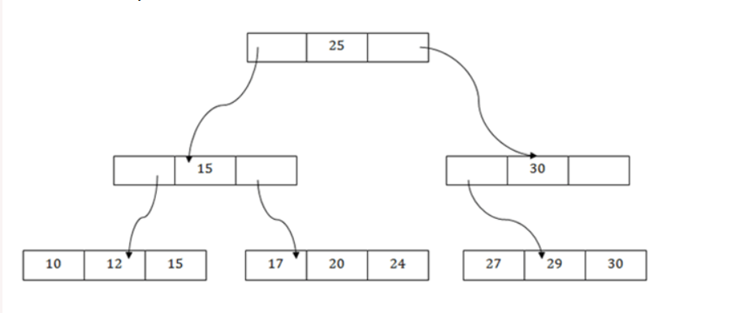

Slide 41
The above B+ tree shows that:
There is one root node of the tree, i.e., 25.
There is an intermediary layer with nodes. They do not store the actual record. They have only pointers to the leaf node.
The nodes to the left of the root node contain the prior value of the root and nodes to the right contain next value of the root, i.e., 15 and 30 respectively.
There is only one leaf node which has only values, i.e., 10, 12, 17, 20, 24, 27 and 29.
Searching for any record is easier as all the leaf nodes are balanced.
In this method, searching any record can be traversed through the single path and accessed easily.

Slide 42
Cons of B+ tree file organization
This method is inefficient for the static tables.

Slide 43
Cluster File Organization
In cluster file organization, two or more related tables/records are stored within same file known as clusters. These files will have two or more tables in the same data block and the key attributes which are used to map these table together are stored only once.
Thus it lowers the cost of searching and retrieving various records in different files as they are now combined and kept in a single cluster.
For example we have two tables or relation Employee and Department. These table are related to each other.

Slide 44
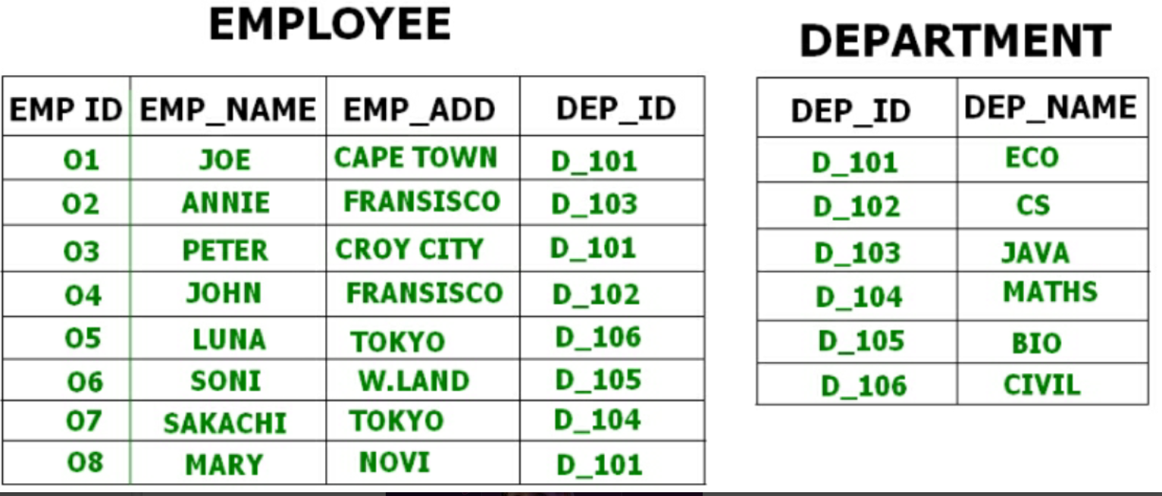
For example we have two tables or relation Employee and Department. These table are related to each other.

Slide 45
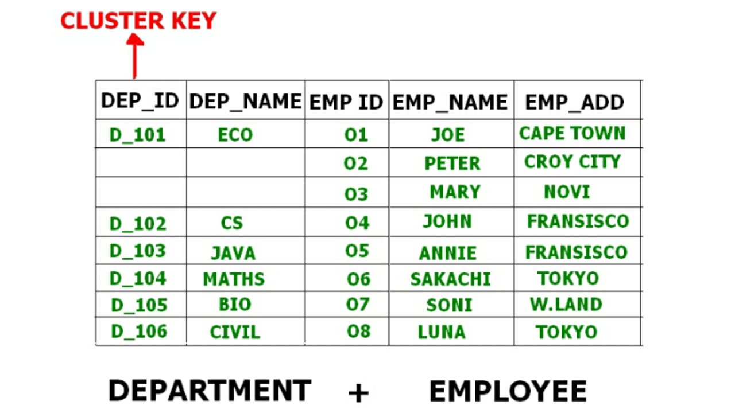
Therefore these table are allowed to combine using a join operation and can be seen in a cluster file.

Slide 46
Types of Cluster File Organization – There are two ways to implement this method:
Indexed Clusters – In Indexed clustering the records are group based on the cluster key and stored together. The above mentioned example of the Employee and Department relationship is an example of Indexed Cluster where the records are based on the Department ID.
Hash Clusters – This is very much similar to indexed cluster with only difference that instead of storing the records based on cluster key, we generate hash key value and store the records with same hash key value.

